Slide 1
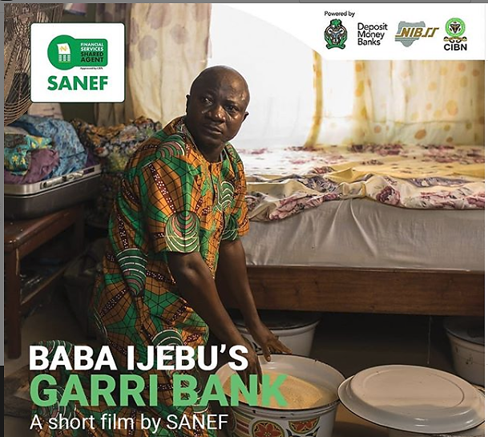
Financial Inclusion in Nigeria- Role of SANEF
Presentation at ALP Seminar Series
20 June 2019

Slide 2
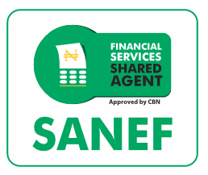
Outline
1
What is Financial Inclusion?
2
Global View of Financial Inclusion
3
Financial Inclusion in Nigeria
4
Establishment of SANEF

Slide 3
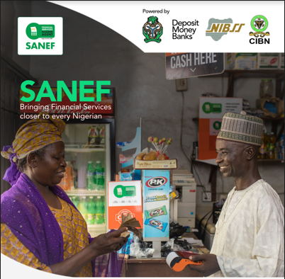
Introduction: What is Financial Inclusion?
“Financial inclusion is where individuals and businesses have access to useful and affordable financial products and services that meet their needs that are delivered in a responsible and sustainable way”
* Financial products – Savings; Credit; Insurance; Pensions

Slide 4
Global View of Financial Inclusion (1/2)
 | Brazil | Kenya | Tanzania | India | Nigeria
Number of Bank Agents | 377,300 | 61,290 | 3,431 | NA | 6,975
Number of Non-Bank Agent | 0 | 170,000 | 147,000 | NA | 11,253
Total Number of Agents | 377,300 (Jan 2015) | 231,290 (Dec 2017) | 150,431 (May 2016) | 500,000 (Nov 2018) | 18,228* (Dec 2017)
Total Number per 100,000 adults (15+) | 248 | 650 | 580 | 17 | 62
Financial Inclusion Rate | 21% (2017) | 73% (2017) | 56% (2017) | 81% (2018) | 63.2% (2018)
Population (2017 est.) | 209.3 million | 49.7 million | 57.3 million | 1.32 billion | 190.9 million
A look at how Nigeria compares to her counterparts by population or region reveals the dire need for evolution of agent banking in Nigeria
*2017 Annual Report, Nigeria Financial Inclusion Strategy, CBN

Slide 5
Global View of Financial Inclusion (2/2):
Critical Success Factors across Countries
Brazil
India
The Central Bank introduced and refined regulations to support the use of agents
Banks adopted agents as means of cost-cutting and reaching people in remote areas
Rolled-out a unique identifier called “AADHAAR”
Relaxed regulations around KYC
Created an all-inclusive financial product -Government Savings Account
The Central Bank (Reserve Bank of India) allowed introduction of Business Correspondents (equivalent to Super Agents in Nigeria) by banks
Kenya
Started with lack of formal regulatory framework e.g. issued only a letter of No Objection initially to permit M-PESA
Agent Banking from success of Mobile Money
Huge support from donors

Slide 6
Status of Financial Inclusion in Nigeria
ecent survey on Financial Inclusion* in Nigeria revealed that 36.8% of the 99.6million adult population are financially excluded as at December 2018
Women -20.4m (56%) of Excluded; 40.9% of Female adult population
Men 16.2m (44%) of Excluded; 32.5% of Male adult population
*Source: EFInA Access to Financial Services in Nigeria 2018 Survey

Slide 7
Timeline of Financial Inclusion in Nigeria
Banks (previously holding mobile money license) shifted focus to providing agent banking
CBN issued a Regulatory Framework for Super Agents
2018
2017
CBN introduced the 1st National Financial Inclusion Strategy as a roadmap to achieve FI targets
Licensed 22 entities to provide mobile money services
2015
CBN released the National Financial Inclusion Strategy, Revised 2018
Launched an exposure draft of new licensing regime for Payment Service Providers
Established the Shared Agent Network Expansion Facilities (SANEF)
2013
2012
2010
CBN introduced Agent Banking as a delivery channel for offering banking services
CBN introduced Mobile Money to include unbanked population

Slide 8
Challenges of Financial Inclusion in Nigeria
Cumbersome process for BVN enrolment
Low proximity to Financial Access Points - only about 17,000 Bank branches to serve 100million Nigerian Adults
High cost to serve for agents and for Super Agents
High cost of transactions to customers
Lack of compelling products to attract the unbanked
Inadequate Financial Literacy and Campaigns among the unbanked, including language barriers
Lack of simple Interoperable Technology/payment platform for account opening and other transactions
Absence of central coordination of stakeholder efforts on Financial Inclusion

Slide 9
Establishment of SANEF
About SANEF
1. 500,000 Financial access points/agents
2. Bank accounts/
BVN to 70 million
Shared Agent Network Expansion Facilities (SANEF) started as a project in February 2018
SANEF was incorporated as a company in January 2019
An intervention to widen and deepen financial access points and services for the purpose of increasing financial inclusion to 80% by 2020
Financial Inclusion - 63.2% as at Dec. 2018
7. Favourable pricing
3. Introduce “No frills” products
6. Interoperable technology platform
4. Financial Literacy and Campaign Awareness
5. Collaboration
with Stakeholders
Objectives of SANEF

Slide 10
SANEF Plans
Provide Support to Super Agents, banks and other stakeholders to acquire agents in 6 geo-political zones
Accelerate and Simplify BVN enrolment
Create Interoperable platform for product deployment, transactions and Account opening
More collaboration between Banks and Super Agents to ramp up Account opening
Introduction of basic products and special Account with benefits designed to attract the unbanked
Engage with Regulatory bodies for favourable policies and conducive environment for growth in Financial Inclusion. Collaborate with interested partners
Drive Financial Literacy and Campaign awareness via Print, Radio, Social media, Community engagements etc
Appropriate pricing for all stakeholders- Super agents, agents and consumers

Slide 11
Advantages….
Cheapest and quickest way to bring Financial Access Points to Nigerians- via collaboration and shared facilities.
Provision of uniform compelling basic products to attract the unbanked
A more coordinated and collaborative way to drive and achieve the Financial Inclusion targets
Easier collaboration with various regulatory bodies and support partners who are focused on driving Inclusion in Nigeria
Uniform message and approach on Financial literacy and campaign awareness to the various geo-political zones Easier to agree on appropriate pricing for the industry Collaboration not Competition will win the Game.

Slide 12
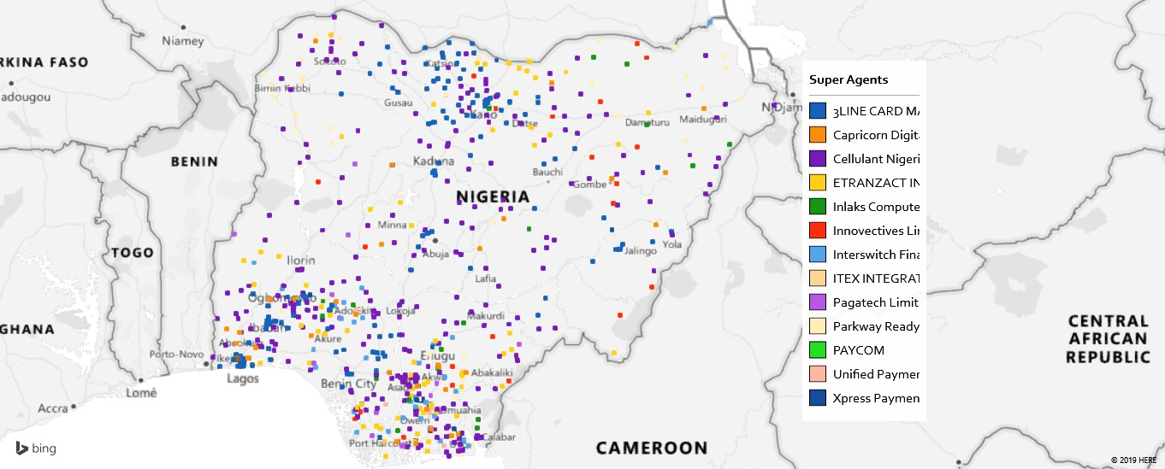
Geographical Spread of Agents by Super Agents

Slide 13
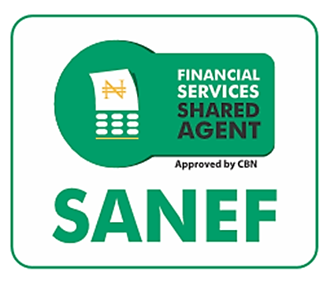
SANEF Super Agents/MMOs
Interswitch
ifiscustomercare@interswitchgroup.com
eTranzact
agentenquiries@etranzact.com
Inlaks
agentenquiries@monidey.ng
Paga
agents@mypaga.com
Cellulant
info@cellulant.com.ng
Capricorn
sanef@capricorndigi.com
Unified Payments
agencynetworkgroup@up-ng.com
Xpress Payments
customercare@xpresspayments.com
Parkway Projects
readycash@parkwayprojects.com
Others with Agent Network
There are 11 licensed Super Agents currently onboard the SANEF intervention programme
3Line
freedomnetwork@3lineng.com
Innovectives
agentenquiries@innovectives.com

Slide 14
Thank You
Uche Uzoebo
Head, Distribution & Engagement
uche.uzoebo@sanefng.com
08033353939
Abimbola Ogunti
Team Lead, Products & Operations
abimbola.ogunti@sanefng.com
08028549263
© June 2019

